Slide 1
FORMING PASSIVE SENTENCES
Week 4

Slide 2

Verbs and Voice
Voice is the form a verb takes to indicate whether the subject of the verb performs or receives the action.
There are two types of voice: active voice and passive voice.

Slide 3
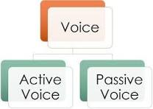

Slide 4
Active Voice
Active Voice – indicates that the subject of the verb is acting
Because the subject does or "acts upon" the verb in such sentences, the sentences are said to be in the active voice.

Slide 5
Active Voice
These examples show that the subject is doing the verb's action.
  The leopard is chasing the antelope.
    The leopard (subject) is doing the chasing (verb).
  Kristy will give a book report to the class.
    Kristy (subject) is doing the giving (verb).

Slide 6
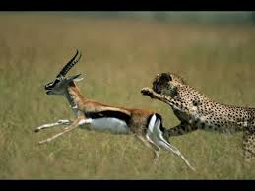
Identify the subject
The leopard is chasing antelope

Slide 7
Passive Voice
In a passive voice sentence, the subject and object flip-flop. The subject becomes the passive recipient of the action.
Because the subject is being "acted upon" (or is passive), such sentences are said to be in the passive voice.

Slide 8
Passive Voice
These examples show the subject being acted upon by the verb.
The boy was jumped on by the dog.
  Boy (subject) was being jumped on (verb)
A book report will be given by Kristy to the class.
  Report (subject) will be given (verb).
My paper was eaten by the computer.
  Paper (subject) was being eaten (verb).

Slide 9
Reasons to Use the Active Voice
We prefer to use active voice because it is more direct.
Compare
  Active: The waiter dropped the tray of food.
  Passive: The tray of food was dropped by the waiter.

Slide 10
Reasons to Use the Active Voice
The active voice is less awkward and clearly states relationship between subject and action.
Compare
  Passive: Your request for funding has been denied by the review committee.
  Active: The review committee denied your request for funding.

Slide 11
When to Use Passive Voice
When the agent is not known, is 'people in general', is unimportant, or is obvious, we prefer passives.
Example:
My office was broken into when I was on holiday, (unknown agent)
An order form can be found on page 2. (agent = people in general)
These boxes should be handled with care, (unimportant agent)
She is being treated in hospital, (obvious agent; presumably 'doctors')

Slide 12
In factual writing, particularly in describing procedures or processes, we often wish to omit the agent, and use passives
e.g.
Nuclear waste will still be radioactive even after 20,000 years,
so it must be disposed off very carefully. It can be stored as a
liquid in stainless-steel containers which are encased in
concrete. The most dangerous nuclear waste can be
turned into glass. It is planned to store this glass in deep
underground mines.
In spoken English, we often use a subject such as people, somebody, they, we, or
you even when we do not know who the agent is. In formal English, particularly
writing, we often prefer to use a passive

Slide 13
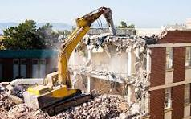
IMPORTANT
Transitive verbs can have a passive form
• They destroyed the building. «—•
The building was destroyed

Slide 14

Intransitive verb can’t have passive forms.
For e.g.
I slept for nearly ten hours last night.

Slide 15
ACTIVITY : Identify the transitive verbs
arrive destroy deteriorate
develop follow exist
happen need prevent
recede release wear

Slide 16
answer
Transitive Verbs:
Destroy
Follow
Need
Prevent
Release
Intransitive Verbs:
Arrive
Deteriorate
Develop
Exist
Happen
Recede
Wear

Slide 17
Exception
Many verbs can be used at different times
with and without objects - that is, they can
be both transitive and intransitive.
e.g. Meet
• Are they meeting him at the station? (transitive)
Is he being met at the airport? (passive)
• When shall we meet?
(intransitive; no passive possible)

Slide 18
Double object
Verbs that can be followed by either
object + object or
object + prepositional object in active clauses
It can have two corresponding passive forms.

Slide 19
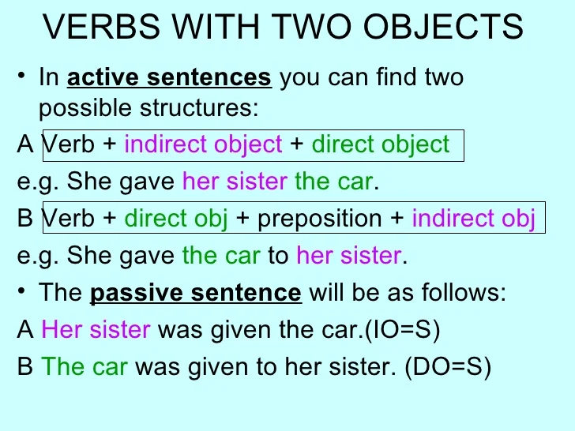

Slide 20
demonstrate,
explain,
introduce, describe
mention,
report, suggest
These verbs have only
one passive form
A: He described the situation to me.
P : The situation was described to me.

Slide 21
Change the voice
Someone mentioned the problem to me.
Someone had reported the theft to the police.
Someone told the story to me.
Someone has given £1,000 to the charity.
Someone will demonstrate the game to the children.

Slide 22
Answers
The problem was mentioned to me.
The theft had been reported to the police.
I was told the story. / The story was told to me.
The charity has been given £1,000. / £1,000 has been given to the charity.
The game will be demonstrated to the children.

Slide 23
We can make a passive form of transitive two- and
three-word verbs
• Martha talked me into buying a motorbike.
(= V + object + preposition) and
• I was talked into buying a motorbike by Martha.
• They gave over the whole programme to a
report from Bosnia. (= V + adverb + object +
preposition) and
• The whole programme was given over to a
report from Bosnia.

Slide 24
Form of Passive Voice Verbs
Writers should be familiar with the forms of "to be" , often called linking verbs, so that they can easily identify the passive voice in their work.
the forms of "to be":
  am, is, are, was, were, be, being, been

Slide 25
Form of Passive Voice Verbs
Note the forms of "to be" in the examples of the verb "to kick" in various forms of the passive voice:
is kicked----------------had been kicked
was kicked-------------is going to be kicked
is being kicked---------will be kicked
has been kicked-------can be kicked
was being kicked------should be kicked

Slide 26
Form of Passive Voice Verbs
Often passive voice sentences will contain a "by" phrase indicting who or what performed the action.
Passive sentences can be easily transformed into active sentences when the object of the preposition "by" is moved to the subject position in the sentence.

Slide 27
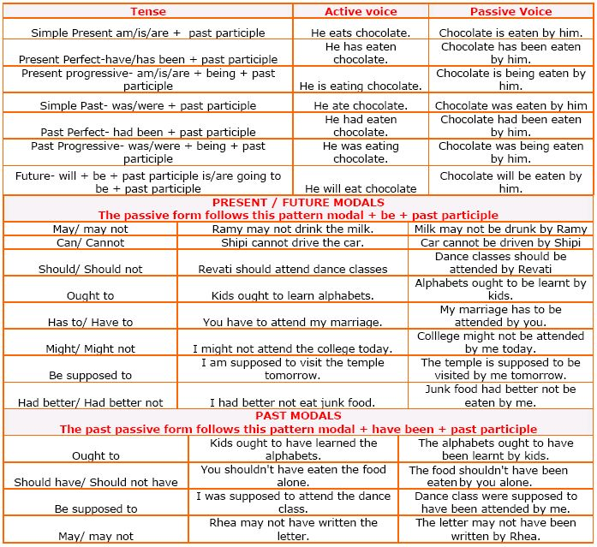

Slide 28
Let’s Practice
Directions: Change the sentences below to the active voice.
  The statue is being visited by hundreds of tourists every year.
  My books were stolen by someone yesterday.
  These books had been left in the classroom by a careless student.
  Coffee is raised in many parts of Hawaii by plantation workers.
  The house had been broken into by someone while the owners were on vacation.

Slide 29
Let’s Practice
Directions: Change the sentences below to the passive voice.
  Children cannot open these bottles easily.
  The government built a road right outside her front door.
  Mr. Ross broke the antique vase as he walked through the store.
  When she arrived, the changes amazed her.
  The construction workers are making street repairs all month long.

Slide 30


